Slide 1
Designing & Optimizing micro batching systems with Cassandra, Spark and Kafka
Accenture

Slide 2
Designing & Optimizing micro batching systems with Cassandra, Spark and
Kafka

Slide 3

Speaker Details and Contact
Ananth Ram
Big Data & Oracle Solution Architect , Accenture
(Accenture Enkitec Group)
Ananth.ram@Accenture.com
Rumeel Kazi
Big Data Solution Architect , Accenture
(Accenture Federal)
rumeel.k.kazi@accenturefederal.com
Rich Rein
Solution Architect , Datastax
Rich.rein@datastax.com

Slide 4
Agenda
Data Acceleration and Micro Batching
Big data Architecture
Technical Architecture
Application Architecture
Data Supply Chain Approach & Framework
Application Design & Operations
Design Considerations
Data Flow
Optimizations and Operations
Application Access Patterns
The Problems and Physics
Idempotency
Partition per Read
Takeaways

Slide 5
Data Acceleration & Micro Batch !
Data as Value Chain
Data Acceleration
Movement
Processing
Insights
High throughput with Micro Batch

Slide 6
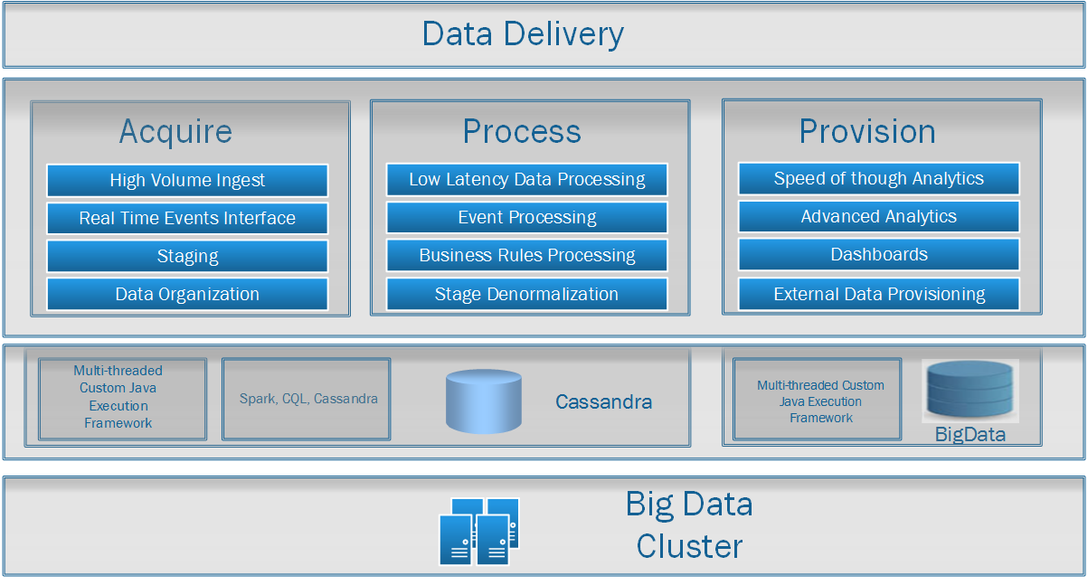
Big Data Architecture

Slide 7
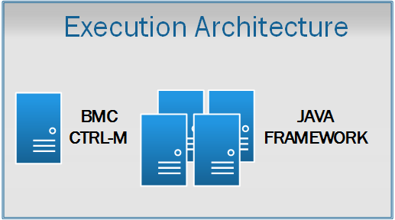
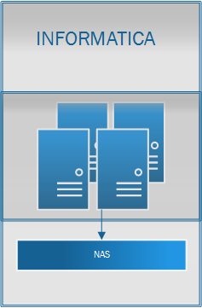
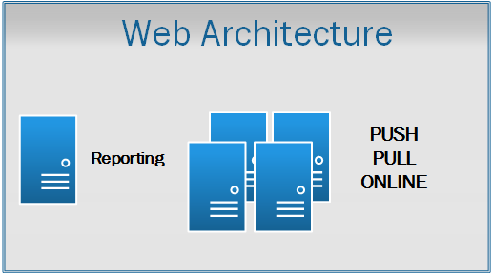
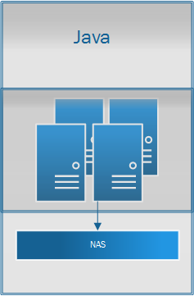
IV Hardware Architecture
Technical Architecture – Sample
Oracle 12c

Slide 8






Technical Architecture – Additional Details
Separate Datacenters for Cassandra and Solr.
Spark is running in the same node as Cassandra for data locality.
Kafka , java spring batch and spark streaming are used to enrich billions of records a day
RAC
4 nodes
12 Nodes
16 Nodes
23 Nodes
Interfaces
Java
Data Ingest
Data
Enrichment
112 Nodes
44 nodes

Slide 9
Application Architecture
Data enriched using java spring batch and spark streaming using kafka as temporary staging area.
Cassandra is used for faster lookups, summary views and persistence storage.

Slide 10
Cassandra, Spark and Kafka Metrics
Cassandra
Cassandra 400K/sec read/writes
Cassandra - 1ms – 3ms Read Latency, 0.2 – 0.3 ms write.
Spark
Spark Streaming processes 200K events/sec.
Spark Streaming runs in the same host as Cassandra for data locality
Kafka
800K/second total messages processed through 30 brokers.
Kafka broker throughput is 30k/messages per broker.
Snappy Compression gives up to 5X throughput in Benchmark. Yet to be tested in our apps.
Java Apps
Java spring batch processes 400K records/sec using 1000’s of threads in apps server.
32GB JVM with GC1 garbage collection with application cache gives this throughput.

Slide 11

Big Data Architecture Approach
Accenture-Data-Acceleration-Architecture-Modern-Data-Supply-Chain.pdf
*Accenture Labs Paper – Carl Dukatz

Slide 12
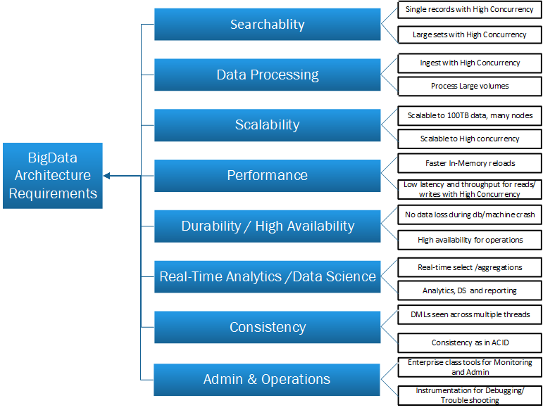
Big Data Architecture Design Considerations - Criteria Sample

Slide 13
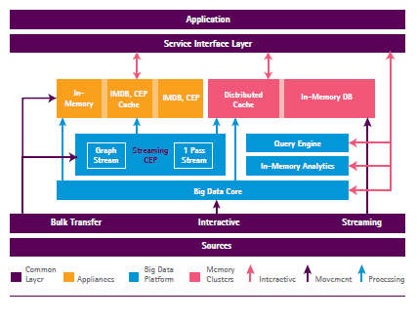
Big Data Design Considerations - Approach
Notes:
Based on Accenture Lab Research Paper: http://www.accenture.com/SiteCollectionDocuments/PDF/Accenture-Data-Acceleration-Architecture-Modern-Data-Supply-Chain.pdf

Slide 14
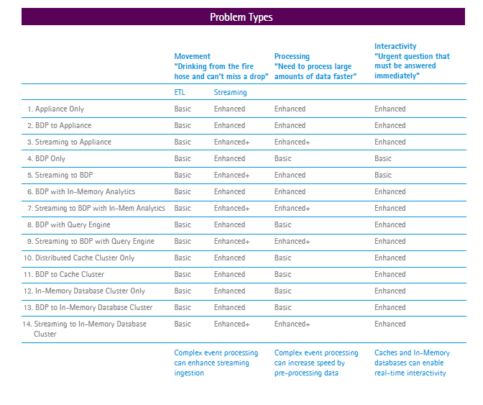
Big Data Design Considerations
Design Considerations & UseCases
Notes:
Based on Accenture Lab Research Paper: http://www.accenture.com/SiteCollectionDocuments/PDF/Accenture-Data-Acceleration-Architecture-Modern-Data-Supply-Chain.pdf

Slide 15
Application Design and Operations

Slide 16
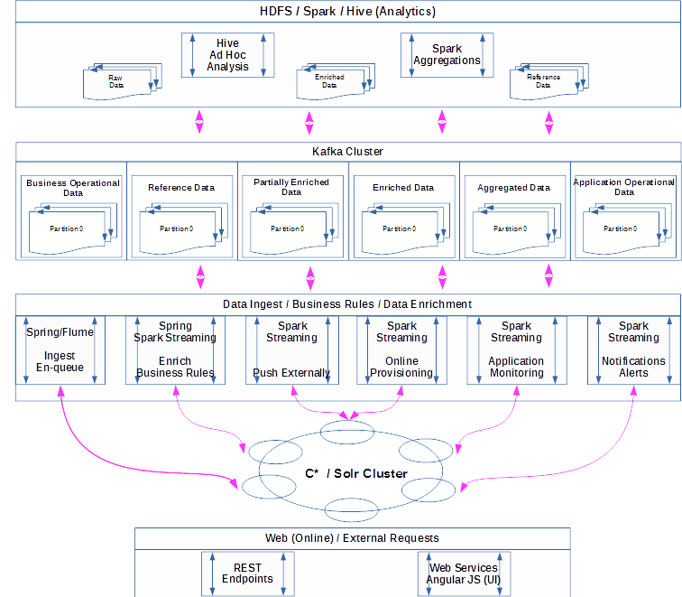
High Level Design Pattern

Slide 17
Data Processing Pipeline

Slide 18
Application Design Considerations
Application Metric Collection / Diagnostic Logging
Include application level operational metrics as part of design. Collect Cassandra and Kafka processing metrics including response times at object level.
Executors report application functionality specific throughput and backlog metric to the driver that then keeps aggregated count of point in time metrics for the process.
Kafka / Cassandra data partitioning strategies
Distribute partitioning keys evenly across the nodes on Cassandra and Kafka brokers. For scenarios where this can’t be done easily when data is skewed to certain data entities that need to be part of partitioning keys, add time windows as part of partitioning keys to avoid data skewed to few nodes.
Time-based partitioning to avoid data skewed to few nodes.
Spark Executor Configurations
Define Spark number of executors to match the number of partitions on the topic. Can have more than one partition per executor depending on the throughput/latency need - keep it low for reduced latency.
Web / Solr Interface Consideration
For consistency requirement, write at consistency-level of ALL on Solr data centers, if it fails write local quorum. Additional sub-second overhead to be considered based on functional needs.

Slide 19
Performance Considerations
Compaction Strategies
Date Tiered v/s Size Tiered Compactions – High resource utilization on over 50 TB sized tables running size tiered compactions on high velocity data and need to consider Date Tiered for time series data.
“Hot Spots” monitoring and actions
Partition keys are chosen to ensure hot data is distributed evenly over the nodes
Application logs with query, keys, and duration for exceeded SLAs can make problems with specific keys known.
Instrument application to rerun the query with CQL trace enabled to see where time was spent.
OpsCenter table metrics can show which nodes contain hotspots
Nodetool toppartitions also shows the hot partition keys on a node

Slide 20
Performance Considerations
Spark batch window optimization and max messages per partitions
Optimize batch duration to not have wasted batch processing time.
Define max messages per partition when executor spans multiple partitions. Prevents OOM exceptions as well as keeps batch processing rate balanced.
Dynamically change max rate based on wasted batch processing time.
DataStax Driver Settings
Separate Transaction data and Searched data into right sized data centers
Search data to be read and written to the same DC.
Use local data center aware strategy in conjunction with token aware.
In-memory tables and Local caching
Limit the number of in-memory tables to constantly changing but smaller tables that are accessed very frequently.
Consider local application caching for frequently accessed data.

Slide 21
Application Operations
Latency & Throughput Monitoring
Application should drive the data instead of technology stacks
Use Splunk or ELK to aggregate, correlate data across nodes
Co-relating Errors
Use tools like Splunk or ELK
Build Custom tools
For Cassandra ( Nodetool, data from Opscenter)
JMX from kafka
Aggregated data in metrics table
Use Java profiler like Yourkit
For Cassandra latency Debugging
Java memory , CPU and contentions
Identify bottlenecks causing by specific methods/calls

Slide 22
Access Patterns

Slide 23
High Speed, Never Stop
The pipeline should never stop or wait
No stopping to upgrade software or hardware
No time for rollback. Roll forward.
No delays that will disrupt the write pipeline or read throughput.
No time for locks, slow reads, large reads, joins, or read-modify-write.
All frequent operations are short.

Slide 24
Affordable
Cost prohibits the frequent unnecessary
No unnecessary frequently read data.
No unnecessary frequently written data.

Slide 25
Pipeline Delays
No
Long operations – Use the correct access patterns
Client congestion
Threads, sockets, heap, CPU, Memory, NUMA Cache
Node congestion
Threads, sockets, heap, CPU, Memory, NUMA Cache
Storage channels
Un-tuned or inconsistently tuned Cassandra nodes
Network and NIC congestion

Slide 26
Physics of the SLA Time Slot
If 2 ms is your target
Think about how many requests can a node process in that time window without congesting the client or node.
Web and IoT tend to be evenly distributed over time, avoiding timeslot contention.
Batch size that can be processed in the time slot?
Careful parallelization may be needed.

Slide 27
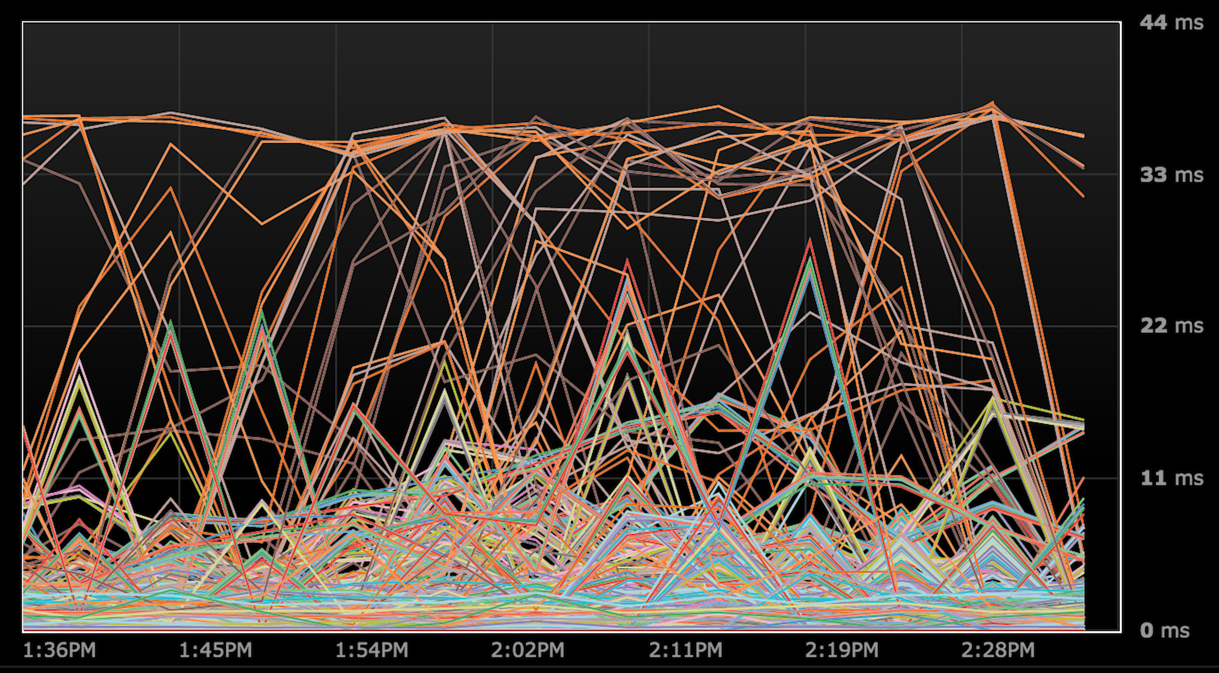
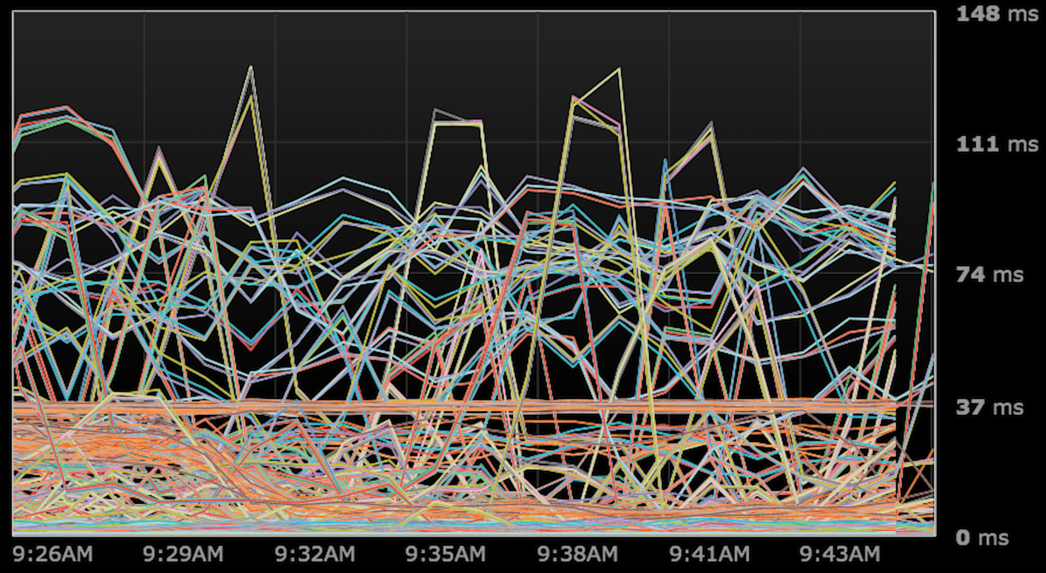
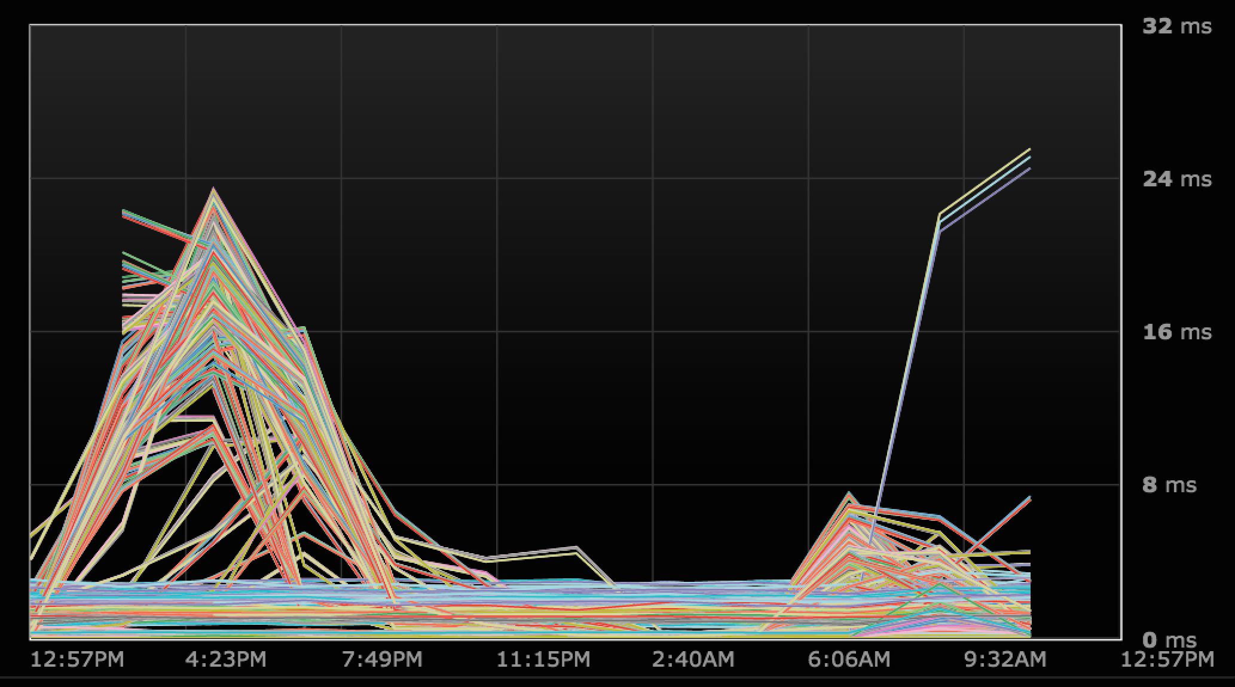
Physics of Partitions
Hot Partitions
Hot Batch or Traffic

Slide 28
Get the Partition Access Patterns Right
Correct table partition keys and access patterns
Scale from 6 nodes to 1000’s
Incorrect
Does not scale by adding nodes
Will not handle more load

Slide 29
Physics of a single Partition
Microseconds | Operation
0.1 | Read and Write RAM
100 | Write Partition
100 | Read Partition from memory
2,000 | Read Hash access to partition in memory and read SSD
20,000 | Read Hash access to partition in memory and read Spindle

Slide 30
Idempotency
Avoid
Lists (collection)
Read-modify-write Updates
Counters
GUIDs only identification of real world objects or actions
Allows client retry (roll-forward)
Allows pipelining of updates without waits

Slide 31
Replace Read-Modify-Write
Replace read-modify-write operations
Counters
Updated aggregates
Lists (collection)
With
data increment values which get aggregated in microbatches
Cassandra 3.0 Aggregates
Sets (collection)

Slide 32
Denormalize
Reads must wait
API Reads are 25-50x slower than writes
Reads consume 5x the resource bandwidth of a write
Disk is far cheaper than RAM, CPU, and Rack
So
Design writes for reads
De-normalization the same as for relational
Multiple materialized views and temp tables
Summary tables

Slide 33
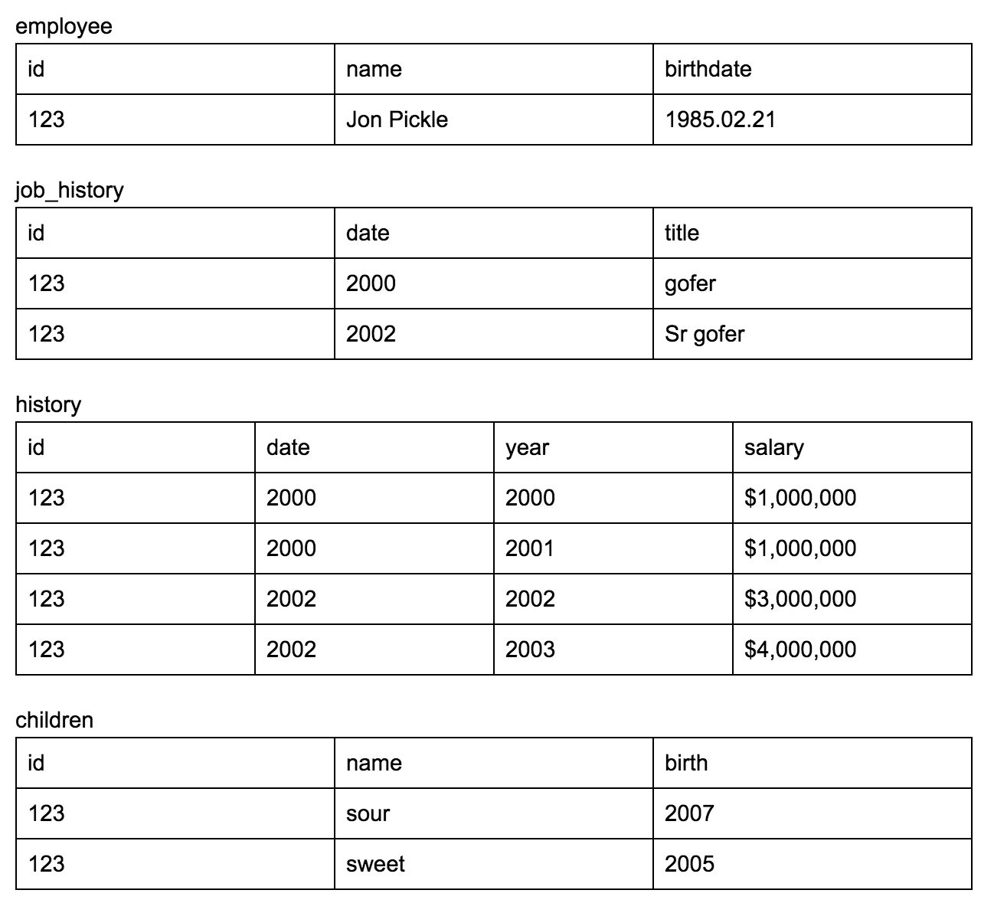
Nesting Rows in the Partitions – 1 of 3

Slide 34
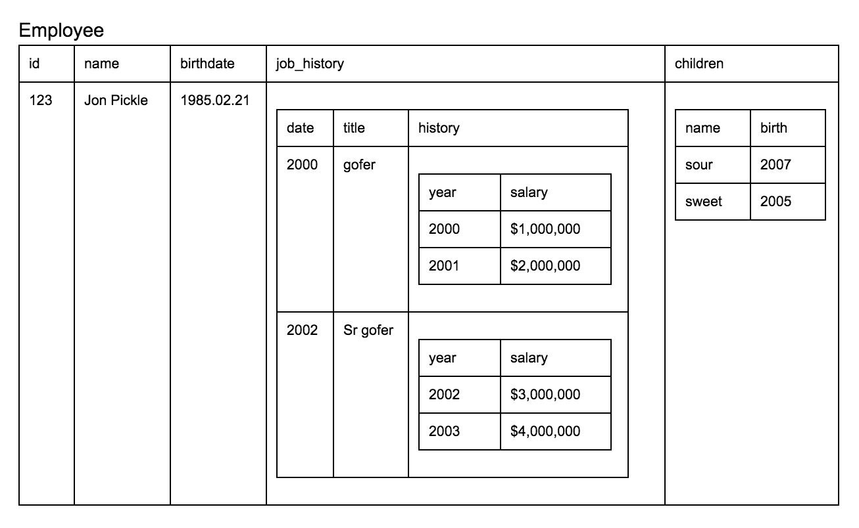
Nesting Rows in the Partitions – 2 of 3
Write nested data to further reduce the read to 1 partition

Slide 35
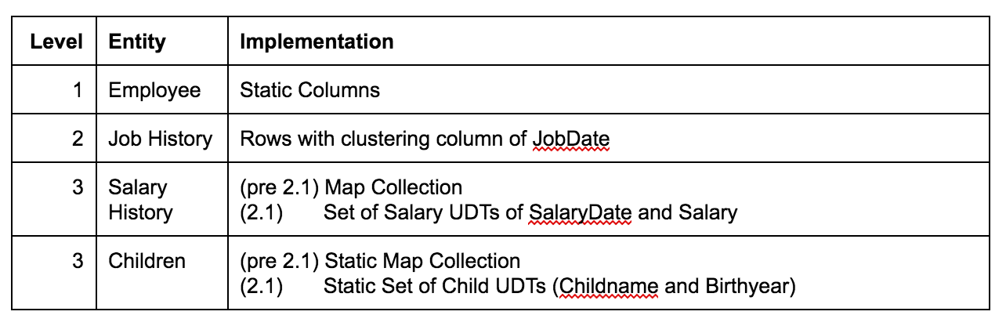
Nesting Rows in the Partitions – 3 of 3
Cassandra allows 3 levels to be nested in a single partition

Slide 36
Summary / Takeaways

Slide 37
Summary / Take Away
Treat data pipeline as value chain and accelerate movement using fit-for-purpose Bigdata stack.
Design your apps to drive latency/throughput visibility
Micro batch in every layer possible to get high throughput
Enrich data in Kafka using spark/spark streaming as process engine.
Cache frequently accessed data closer to code to get best throughput.
Focus on datamodel and Access patterns
Review distinct features of Bigdata technology platform for data acceleration (Accenture Approach white paper).

